Slide 1
Database Fundamentals Module 4: Optimizing Performance
Chris Randall and Graeme Malcolm

Slide 2


So Graeme, my database has a lot of data in it, and my queries are taking a long time to complete. What can I do?
Well, Chris, let’s look at some ways we can optimize query performance in a database…

Slide 3
Aaaaaaaaaa
Bbbbbbbbb
Ccccccccccc
Ddddddddd
Eeeeeeeeee
Ffffffffffffffff
1
Gggggggggg
Hhhhhhhhh
Iiiiiiiiiiiiiiiiiiiii
Jjjjjjjjjjjjjjjjjjjjj
Kkkkkkkkkkk
Llllllllllllllllllll
2
Mmmmmm
Nnnnnnnnn
Ooooooooo
Ppppppppp
Qqqqqqqqq
Rrrrrrrrrrrrr
3
Abcdef…..1
Bcdefg.....1
Hijklm……3
Opqrs…….2

Slide 4
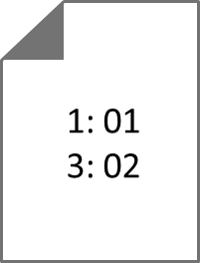

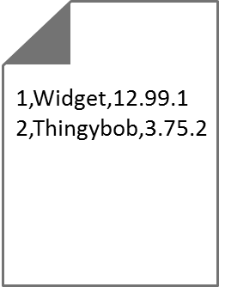
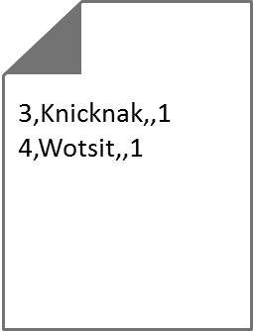

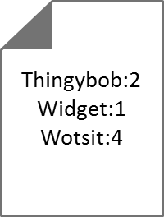
Sales.Product
ProductID | Name | Price | Supplier
1 | Widget | 12.99 | 1
2 | Thingybob | 3.75 | 2
3 | Knicknack | NULL | 1
4 | Wotsit | NULL | 1
CREATE CLUSTERED INDEX idx_ProductID
ON Sales.Product (ProductID);
CREATE NONCLUSTERED INDEX idx_Name
ON Sales.Product (Name);

Slide 5
A clustered index determines the order in which rows are stored
You can create only one clustered index per table
A table without a clustered index is a heap
A non-clustered index stores pointers
To the row ID of a heap, or the cluster key of a clustered index
You can create multiple non-clustered indexes on a table

Slide 6
Indexes
Creating clustered and nonclustered idnexes

Slide 7
That’s terrific Graeme, but it looks like there’s still a lot of reading data from disk – isn’t that slow?
Well, Chris, slow is a relative term – but yes, disk I/O is the biggest performance bottleneck. Fortunately, we can make use of ever cheaper memory…

Slide 8
Sales.Product
ProductID | Name | Price | Supplier
1 | Widget | 12.99 | 1
2 | Thingybob | 3.75 | 2
3 | Knicknack | NULL | 1
4 | Wotsit | NULL | 1
Segment
Segment
Segment
Segment
Page 1
Rowgroup 1
1 | Widget | 12.99 | 1
2 | Thingybob | 3.75 | 2
1 |  | Widget |  | 12.99 |  | 1
2 |  | Thingybob |  | 3.75 |  | 2
3 |  | Knicknack |  | NULL |  | 1
4 |  | Wotsit
Rowgroup 2
Page 2
3 | Knicknack | NULL | 1
4 | Wotsit | NULL | 1

Slide 9
Sales.Product
ProductID | Name | Price | Supplier
1 | Widget | 12.99 | 1
2 | Thingybob | 3.75 | 2
3 | Knicknack | NULL | 1
4 | Wotsit | NULL | 1
CREATE CLUSTERED COLUMNSTORE INDEX idx_Product
ON Sales.Product;
1 |  | Widget |  | 12.99 |  | 1
2 |  | Thingybob |  | 3.75 |  | 2
3 |  | Knicknack
4 |  | Wotsit

Slide 10
Sales.Product
ProductID | Name | Price | Supplier
1 | Widget | 12.99 | 1
2 | Thingybob | 3.75 | 2
3 | Knicknack | NULL | 1
4 | Wotsit | NULL | 1
CREATE NONCLUSTERED COLUMNSTORE INDEX idx_Name
ON Sales.Product (ProductID, Name);
1 |  | Widget
2 |  | Thingybob
3 |  | Knicknack
4 |  | Wotsit

Slide 11
Columnstore indexes:
Are stored in memory
Store data by column instead of by row
Use compression to optimize memory usage and performance
Columnstore indexes can be clustered or non-clustered
Clustered columnstore indexes include all columns
Only one clustered columnstore index per table

Slide 12
Columnstore Indexes
Creating columnstore indexes

Slide 13
Anything else we can do with in-memory technologies Graeme?
Well, Chris, I’m glad you asked…

Slide 14

Sales.Product
ProductID | Name | Price | Supplier
1 | Widget | 12.99 | 1
2 | Thingybob | 3.75 | 2
3 | Knicknack | NULL | 1
4 | Wotsit | NULL | 1
BEGIN TRANSACTION;
UPDATE Sales.Product
SET Price = 1.99
WHERE ProductID = 3;
SELECT Price
FROM Sales.Product
WHERE ProductID > 2;
COMMIT TRANSACTION;

Slide 15
Sales.Product
ProductID | Name | Price | Supplier
1 | Widget | 12.99 | 1
2 | Thingybob | 3.75 | 2
3 | Knicknack | NULL | 1
4 | Wotsit | NULL | 1
struct{
…
}
CREATE TABLE Sales.Product
(ProductID...,
Name...,
Price...,
Supplier...)
WITH (MEMORY_OPTIMIZED = ON);
EXECUTE Sales.InsertProduct;
CREATE PROCEDURE Sales.InsertProduct
WITH NATIVE_COMPILATION,
SCHEMABINDING,
EXECUTE AS OWNER
AS
INSERT INTO Sales.Product...;
struct{
…
}

Slide 16
Memory Optimized Tables:
Are compiled C# structs
Are stored in memory
Can be accessed using Transact-SQL or native stored procedures
Native stored procedures:
Are compiled C# code
Are stored in memory

Slide 17
Memory Optimized Tables
Creating memory-optimized tables an native stored procedures

Slide 18
So it looks like there are a lot of ways to optimize database performance Graeme.
Yes Chris, let’s remind ourselves…

Slide 19
Use indexes to optimize SELECT performance
Each table can have one clustered index
You can create multiple non-clustered indexes per table
Columnstore indexes can improve some workloads
Particularly data warehouse queries with highly compressible data
Memory optimized tables offer high performance
Use these for contention-bound workloads
Optimize further with native stored procedures

